Slide 1
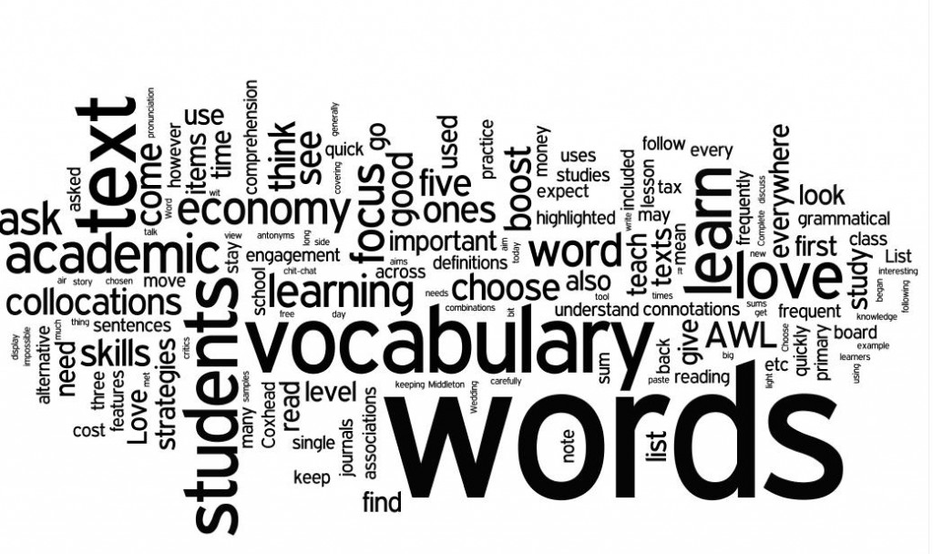
Understanding the thinking routine: generate-sort- connect-elaborate

Slide 2
Sentence-Phrase-word
The Value of Intentional
Vocabulary Instruction in the Middle Grades
Select a sentence from the article that took your thinking in new directions.
Select a phrase, not in your sentence, that either supports your sentence or represents another major idea.
Select a word that you found powerful in the article.

Slide 4
Big ideas :
Strong vocabulary development correlates highly with strong concept development and school success
Vocabulary study must include understanding the relationship between words and concepts
Students must engage with words at a comprehension level (sort and categorize) as well as a generative level (making connections and drawing conclusions)
Meaningful engagement with peers in strengthens vocabulary learning

Slide 5
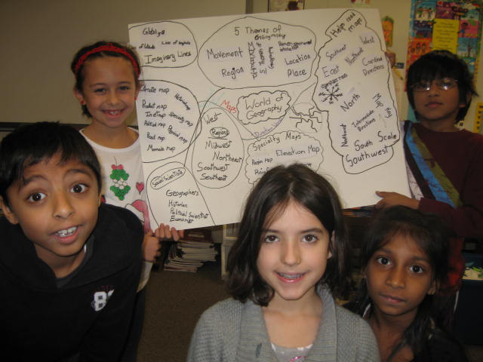
Generate-Sort Connect-elaborate
A Thinking Routine for Synthesizing and Organizing Ideas Into a Concept Map

Slide 6
Engaging with vocabulary at a Comprehension level:
In small groups or together as a class, students generate a list of words associated with a topic being studies
Working in small groups, students sort their words into groups that have something in common
Each group of words is given a title that conveys the common connection

Slide 7
Engaging with vocabulary at a generative level
Connections are made among the different groups of words by drawing lines between groups and describing the connection on the line
Students pick a few central ideas and elaborate by extending thinking or adding new thoughts

Slide 8
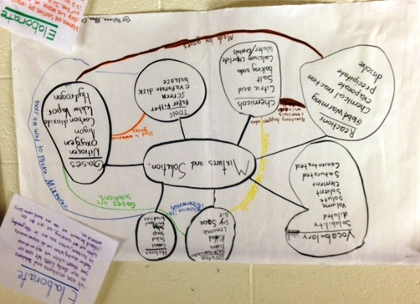
Generate-Sort-Connect-elaborate
https://www.dropbox.com/s/1dj9sqaw2e95szy/Generate%20Sort%20Erin.mov?dl=0https://www.dropbox.com/s/1dj9sqaw2e95szy/Generate%20Sort%20Erin.mov?dl=0
Third Grade Science

Slide 9
#generatesortconnectelaborate
How might this routine work for you in your classroom?

Slide 10
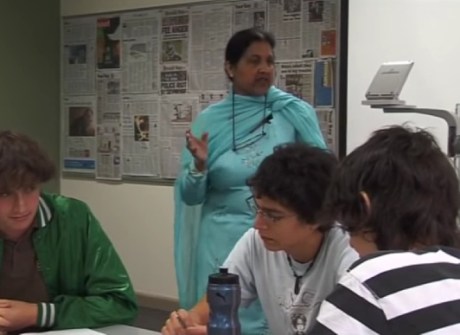
Generate-sort-connect-elaborate
High School Language Arts
A Different Twist
https://dragontv.ssis-suzhou.net/podcasts/teachers-tv/vtr-generate-sort-connect-elaborate

Slide 11
#generatesortconnectelaborate
How might this version of the routine work for you in your classroom?

